Slide 1
SLEEP MONITORING APP
Elumalai M (712822243013)
Sabitha RJ (712822243041)
Vigneshwaran M (712822243057)
Deenul Safiq S (712822243011)

Slide 2
PROJECT OBJECTIVES
The objective of the Sleep Tracker app is to help users monitor and improve their sleep quality by providing insights into their sleep patterns. The app aims to provide a simple and intuitive platform for tracking sleep, identifying sleep quality, and offering personalized feedback. By using this app, users can:
Track the time they spend asleep. Rate the quality of their sleep upon waking. Receive an analysis of their sleep patterns. Improve their overall sleep hygiene and well-being.

Slide 3
FUNCTIONALITIES
Sleep Timer: The app includes a sleep timer that starts when the user is about to fall asleep and runs in the background until the user wakes up. Sleep Quality Rating: After waking up, the user can rate the quality of their sleep on a scale (e.g., from 1 to 5 stars), providing feedback on how well they slept. Sleep Analysis: The app analyzes the recorded sleep data (such as sleep duration and quality rating) to generate insights into the user’s sleep patterns, helping them understand their sleep cycle better. Sleep History: Users can view a history of their past sleep sessions, including the time slept, quality ratings, and any notable trends in their sleep patterns. Reminders and Notifications: Optional notifications can remind users to go to bed or encourage them to keep a consistent sleep schedule.

Slide 4
ADDITIONAL REQUIREMENTS
UI Design: The app will use Android Jetpack Compose for building a modern, responsive, and user-friendly interface. Background Services: The app will utilize background services to keep track of the sleep timer while the user is in bed and prevent interruptions. Data Privacy and Security: User data, such as sleep history, will be stored securely and only accessible by the user. Battery Optimization: The app will be optimized to minimize battery usage while tracking sleep. App Analytics: The app will track user behavior (optional) to improve its features and recommendations.

Slide 5
Package com.example.projectone
import android.content.Context
import android.content.Intent
import android.icu.text.SimpleDateFormat
import android.os.Bundle
import androidx.activity.ComponentActivity
import androidx.activity.compose.setContent
import androidx.compose.foundation.Image
import androidx.compose.foundation.layout.*
import androidx.compose.material.Button
import androidx.compose.material.MaterialTheme
import androidx.compose.material.Surface
import androidx.compose.material.Text
import androidx.compose.runtime.*
import androidx.compose.ui.Alignment
import androidx.compose.ui.Modifier
import androidx.compose.ui.draw.alpha
import androidx.compose.ui.layout.ContentScale
import androidx.compose.ui.res.painterResource
import androidx.compose.ui.unit.dp
import androidx.core.content.ContextCompat
import com.example.projectone.ui.theme.ProjectOneTheme
import java.util.*

Slide 6
class MainActivity : ComponentActivity() {
private lateinit var databaseHelper: TimeLogDatabaseHelper
override fun onCreate(savedInstanceState: Bundle?) {
super.onCreate(savedInstanceState)
databaseHelper = TimeLogDatabaseHelper(this)
databaseHelper.deleteAllData()
setContent {
ProjectOneTheme {
// A surface container using the ‘background’ color from the theme
Surface(
modifier = Modifier.fillMaxSize(),
color = MaterialTheme.colors.background
) {
MyScreen(this,databaseHelper)
}
}
}
}
}

Slide 7
@Composable
fun MyScreen(context: Context, databaseHelper: TimeLogDatabaseHelper) {
var startTime by remember { mutableStateOf(0L) }
var elapsedTime by remember { mutableStateOf(0L) }
var isRunning by remember { mutableStateOf(false) }
val imageModifier = Modifier
Image(
painterResource(id = R.drawable.sleeptracking),
contentScale = ContentScale.FillHeight,
contentDescription = “”,
modifier = imageModifier
.alpha(0.3F),
)
Column(
modifier = Modifier.fillMaxSize(),
horizontalAlignment = Alignment.CenterHorizontally,
verticalArrangement = Arrangement.Center
) {
if (!isRunning) {
Button(onClick = {
startTime = System.currentTimeMillis()
isRunning = true
})

Slide 8
{
Text(“Start”)
//databaseHelper.addTimeLog(startTime)
}
} else {
Button(onClick = {
elapsedTime = System.currentTimeMillis()
isRunning = false
}) {
Text(“Stop”)
databaseHelper.addTimeLog(elapsedTime,startTime)
}
}
Spacer(modifier = Modifier.height(16.dp))
Text(text = “Elapsed Time: ${formatTime(elapsedTime – startTime)}”)
Spacer(modifier = Modifier.height(16.dp))
Button(onClick = { context.startActivity(
Intent(
context,
TrackActivity::class.java
)
) })

Slide 9
{
Text(text = “Track Sleep”)
}
}
}
private fun startTrackActivity(context: Context) {
val intent = Intent(context, TrackActivity::class.java)
ContextCompat.startActivity(context, intent, null)
}
fun getCurrentDateTime(): String {
val dateFormat = SimpleDateFormat(“yyyy-MM-dd HH:mm:ss”, Locale.getDefault())
val currentTime = System.currentTimeMillis()
return dateFormat.format(Date(currentTime))
}
fun formatTime(timeInMillis: Long): String {
val hours = (timeInMillis / (1000 * 60 * 60)) % 24
val minutes = (timeInMillis / (1000 * 60)) % 60
val seconds = (timeInMillis / 1000) % 60
return String.format(“%02d:%02d:%02d”, hours, minutes, seconds)
}

Slide 10
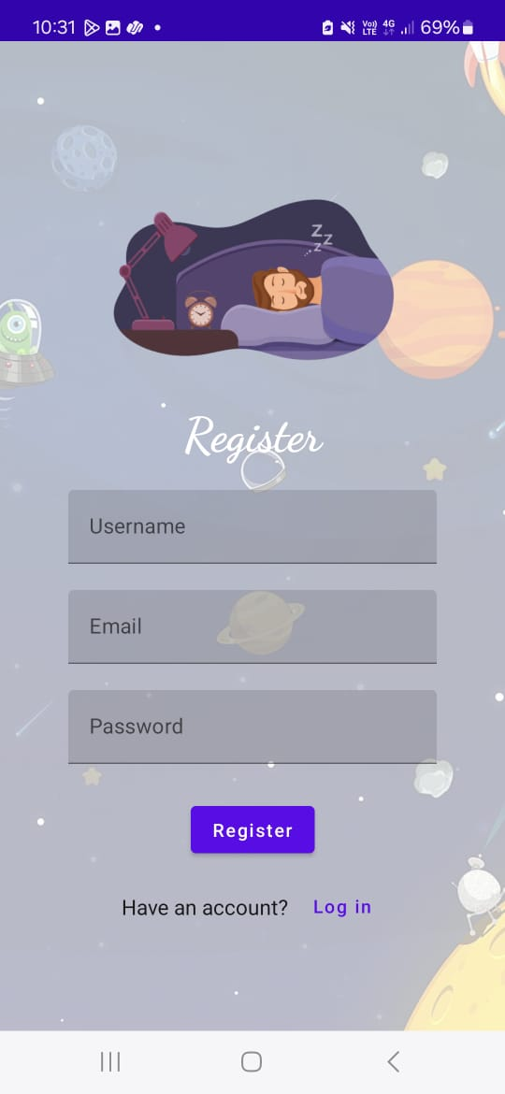
Output:

Slide 11
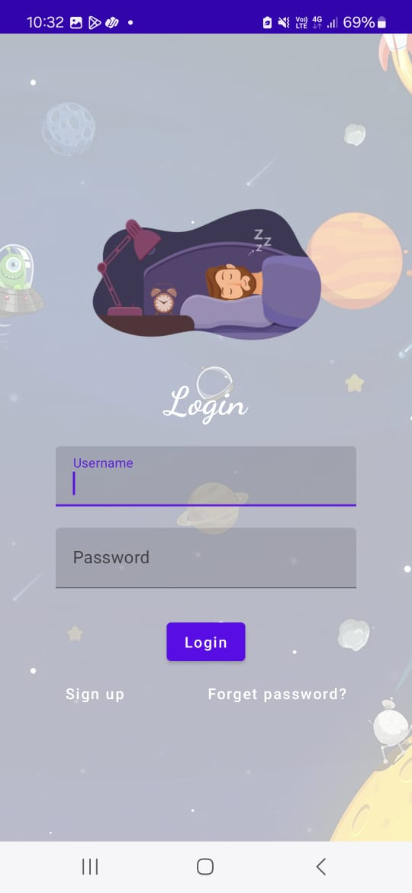

Slide 12
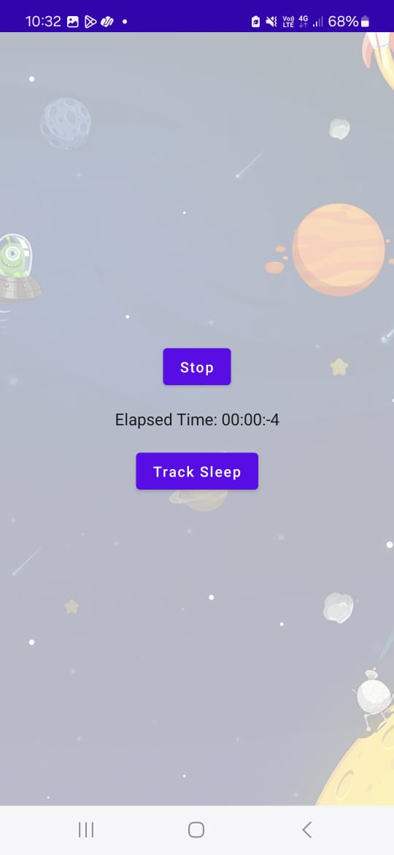

Slide 13
